Slide 1
Fossils Teach Us
4th Grade Common Core

Slide 2
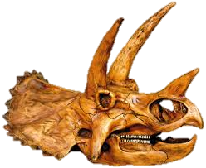
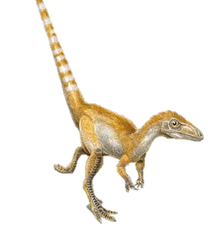
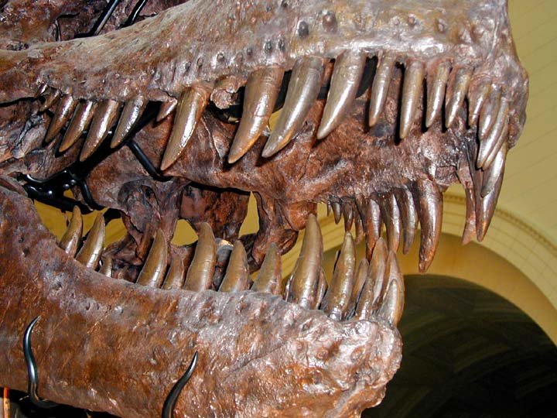
Fossils Teach Us About Life: What Did Dinosaurs Eat?
Look at the pictures of dinosaurs and try to decide which thing they ate from the other column.

Slide 3
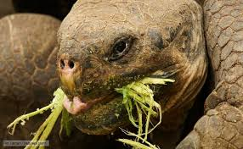
We Compare Fossils to Now
Remember the Triceratops mouth?
How do we know that they were plant eaters?
WE COMPARE THEM TO ANIMALS NOW!
What do you notice?

Slide 4
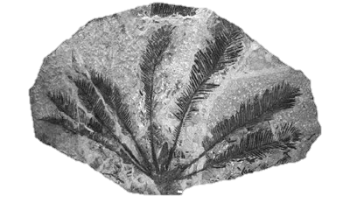
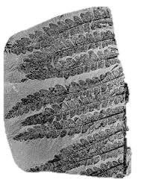
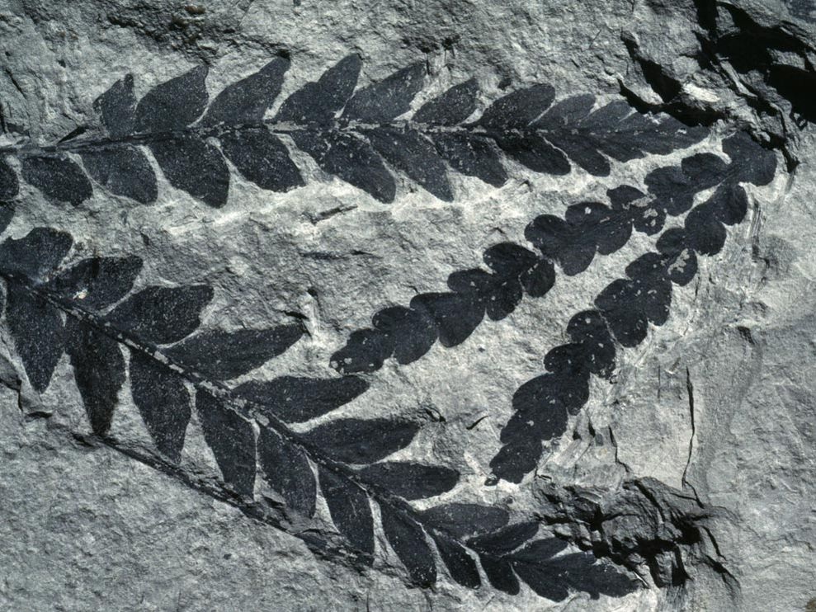
Fossils Teach Us About Life: What Plants Existed?
Not only did dinosaurs become fossils, but PLANTS did too! This way we are able to look at what plants existed.

Slide 5
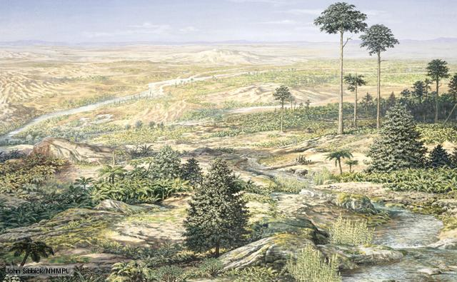
Scientists Use This To Make Educated Guesses
This is a scientist’s IDEA of what ancient earth MIGHT HAVE looked at one point.

Slide 6
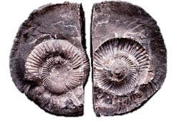
Fossils Teach Us About Life: Has Earth Changed?
Something we know is Earth changes every day. There are always new volcano eruptions, earthquakes, floods, and other natural occurrences that change the way Earth looks. Mountains grow, valleys form.
Fossils help us learn more about how the Earth has changed.
For example: What comes to mind when you see these fossils? Where were they found?
Pair/Share with an elbow partner.

Slide 7
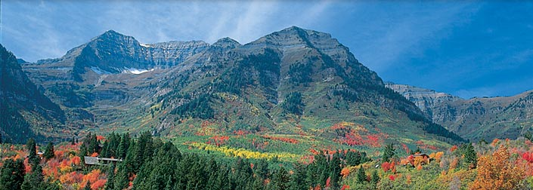
Fossils Teach Us About Life: Has Earth Changed?
You probably decided these fossils were found near an ocean or lake . . . But they were found in an area that looks like this:
Scientists use this information to learn that Earth changed and this USED to be UNDERWATER! By the way, this is UTAH.

Slide 8
Lake Bonneville
Lake Bonneville was a predominantly freshwater lake that formed about 32,000 years ago and covered 20,000 square miles (almost a quarter of Utah). It reached depths of 1,000 feet, compared to about 33 feet today and a 13-foot average depth). 14,500 years ago, a breach in a sandstone wall, now known as Red Rock Pass, Idaho, resulted in the biggest flash flood this planet has ever known. Water poured through at an estimated 159,000,000 gallons of water every SECOND—the lake dropped around 350 feet in just a couple of weeks. Only 500 years later, severe droughts nearly eliminated the lake altogether! Old shorelines and fossils left by Lake Bonneville can be found and seen up in the mountain ranges surrounding the Salt Lake Valley.

Slide 9
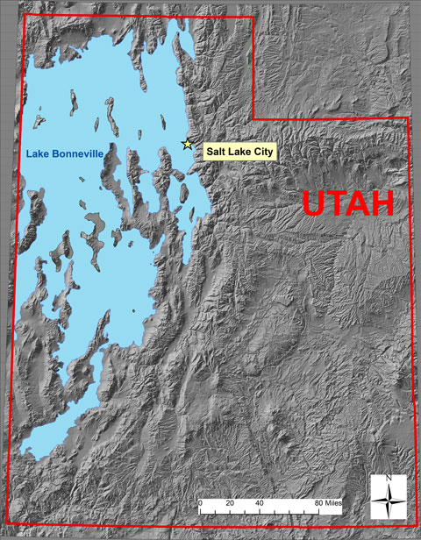
Lake Bonneville
There used to be a lot more water in Utah than there is now.
All that’s left is the Great Salt Lake – and this is much, much smaller!
Because of fossils, we know that Utah has changed A LOT.

Slide 10
Brochure Time
Complete the Brochure of Utah: Then and Now to analyze how Utah has changed over time.

